Slide 1
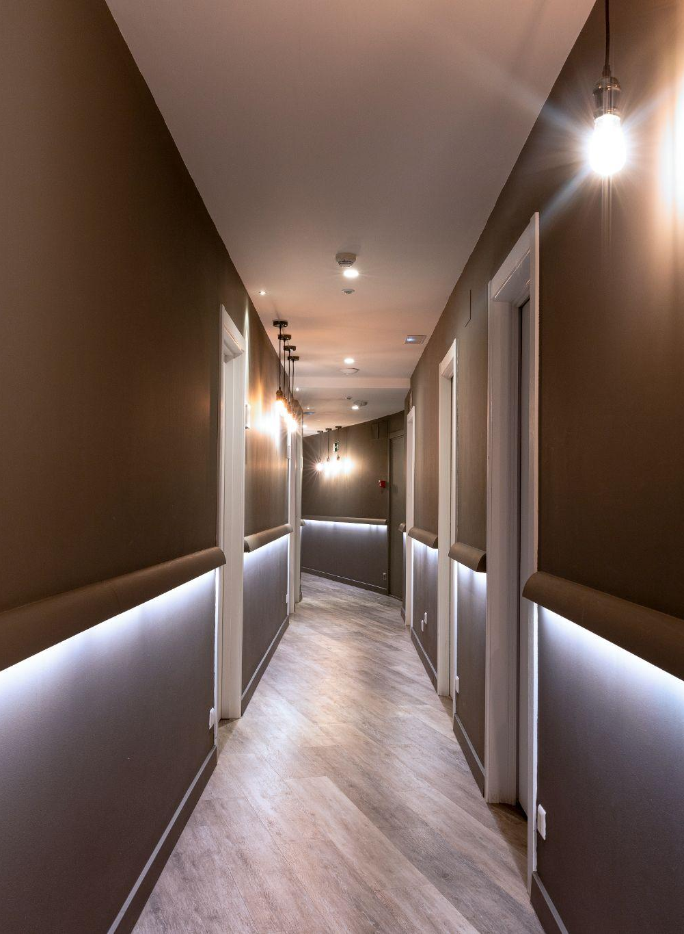
DREAM HOTEL
CANCUN MEXICO
2022
Potential Links
Bookings button
Potential links
HOTEL

Slide 2
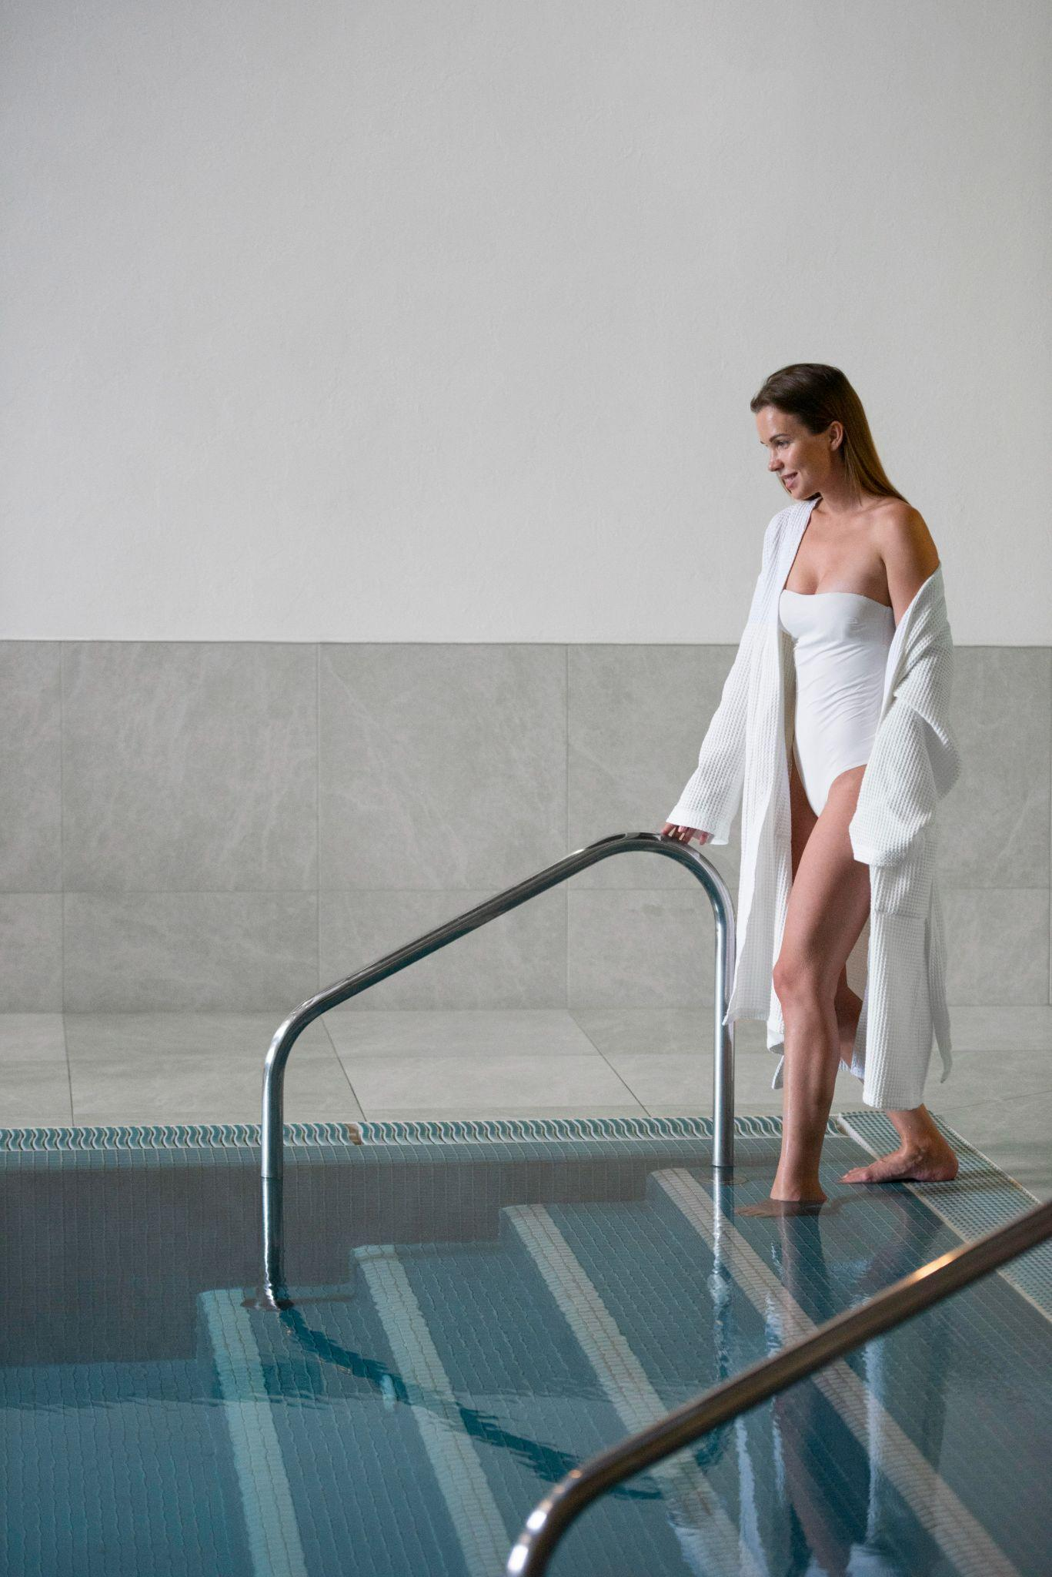
Types of rooms
6 different
Restaurants
01
02
Book Rooms Now
TABLE OF CONTENTS
Book a restaurant
King size
Queen size
Twin size
Smoking or non-smoking
Restaurant descriptions

Slide 3
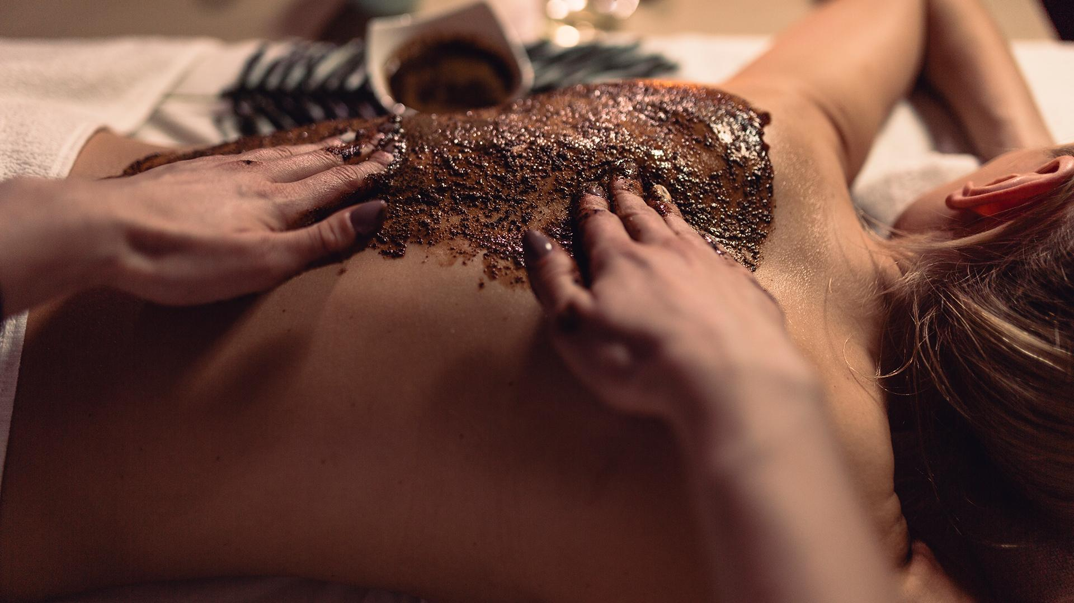
Room Bookings
Section
2022
links
Booking button
links

Slide 4
PRICES PER ROOM
 | JAN | FEB | MAR | APR | MAY | JUN | JUL | AGO | SEP | OCT | NOV | DEC
Double classic | 174 | 180 | 240 | 200 | 225 | 140 | 130 | 140 | 150 | 250 | 270 | 290
Double superior | 185 | 190 | 240 | 200 | 170 | 210 | 315 | 340 | 350 | 210 | 190 | 190
Double deluxe | 205 | 270 | 230 | 250 | 260 | 280 | 350 | 295 | 320 | 430 | 550 | 700
Jr. suite | 260 | 160 | 230 | 320 | 260 | 345 | 310 | 390 | 400 | 320 | 380 | 500
Single | 115 | 145 | 159 | 132 | 142 | 139 | 151 | 120 | 115 | 132 | 145 | 159

